Slide 1
Resume Review Workshop
Ilir Gusija

Slide 2
Overview
Intro
Resume
Contact Info
Intro
Education
Content
Format
Your turn!
Additional tips
Resources
Questions!

Slide 3
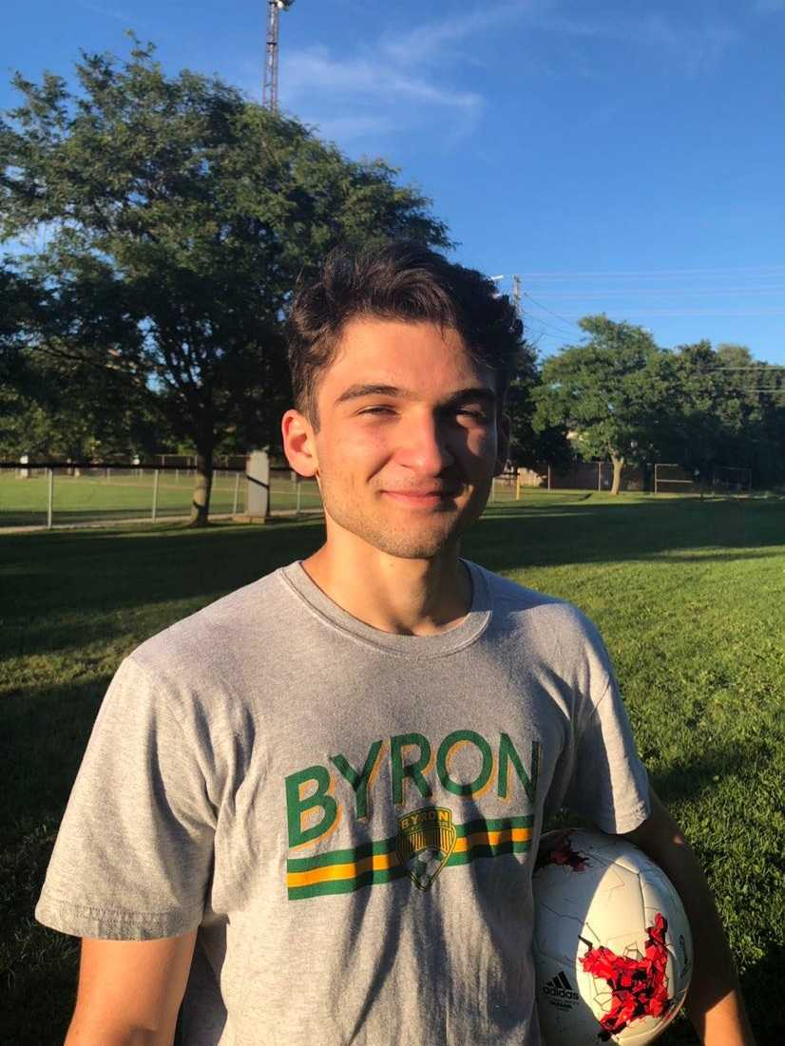
Who Am I?
Chair of Industry Relations
3rd year Apple Comp
Currently looking for internship through QUIP

Slide 4
DISCLAIMER
Notes:
THIS IS ALL OUR OPINION. DO NOT TREAT WHAT WE SAY AS COMPLETE FACT BUT USE IT TO SUPPLEMENT YOUR RESUME WRITING EXPERIENCE. IF YOU DISAGREE WITH ANYTHING WE SAY LET US KNOW ON OUR FEEDBACK FORM AT THE END OF THE PRESENTATION!

Slide 5
Before We Jump In
We will be focusing on “cutting the excess” out of your resume
This workshop is tailored towards getting your first internship/job
(Resume writing for other positions may take up a different process)

Slide 6
Contact Information
Have an email that includes your full name!
Include any additional resources!
Notes:
Name:
Since this is not a legal document you do not need to include legal name
Email:
School email can be changed on solus https://netid.queensu.ca/selfservice/login/auth
Additional resources
Github
Website
The first part of your resume is going to always be your contact information. This can be formatted a number of different way but essentially it should include your name, phone number, email, and then any other resources you may have such as linkedin or GitHub

Slide 7
Introduction
Profile
Summary
Objective
Notes:
Profile
Statement that introduces you and summarizes you as a candidate in 2-3 sentences.
Summary
Similar to profile
Takes key points from resume and puts them at the top
Objective
This is somewhat similar to a profile
Lets employer know what you’re looking for exactly in a position
The next part of the resume if you choose to include it is the introduction. This is where you can summarize some of the key points that make you a good candidate for the position. It can consist of a summary, profile, and or objective. It is usually redundant to include both a summary and an objective as they are essentially the same thing. With the summary, it is a good idea to highlight your most relevent qualities with one bullet point in the order that they will appear in the rest of the resume. With a profile or objective, try to describe yourself in a couple sentences using what are called impactful words. These will be described further later in the workshop. One last thing to note is that out of all the sections this one in my opinion is the least important. So if you are short on space it is likely ok to omitt it.

Slide 8
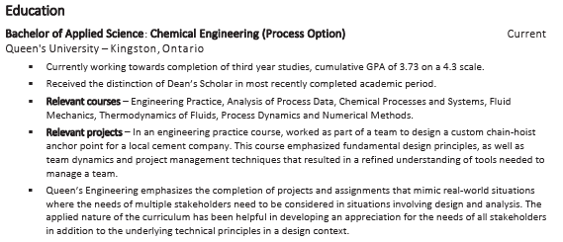
Education
Include GPA (General rule is > 3.5)
Relevant coursework/projects
Awards/involvement
Omit high school
Put expected graduation date
Notes:
If GPA is above 3.7 include it, if not you probably shouldn’t
Describe non-obvious course titles
Only include high school if in first year

Slide 9
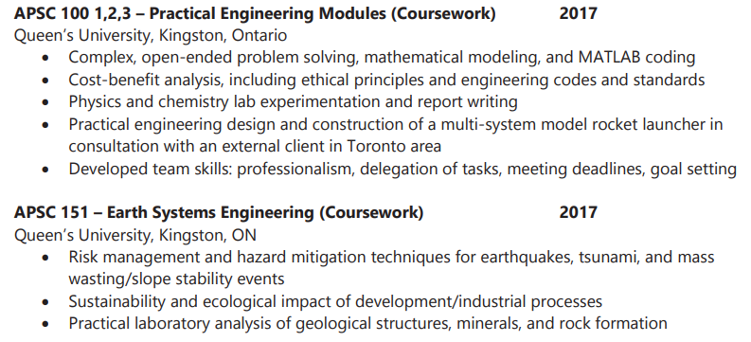
Education
Good to go more in depth on courses when lacking in other experiences
Good resource for descriptions googling the course calendar for your program.
These examples specifically would do better with more outcomes
Notes:
If GPA is above 3.7 include it, if not you probably shouldn’t
Describe non-obvious course titles
Only include high school if in first year

Slide 10
Content
Notes:
Grammar/Spelling:
Common mistake is not using apostrophe in Bachelor’s degree
Outcome
Adding achievements to your experiences are what employers look for
The bare minimum is performing tasks on the job; what you achieve is what sets you apart
Quantifying experiences is the number 1 biggest difference maker I’ve seen online in people’s job searches

Slide 11
Content
What You Did:
Only pick relevant experiences!
Notes:
Grammar/Spelling:
Common mistake is not using apostrophe in Bachelor’s degree
Outcome
Adding achievements to your experiences are what employers look for
The bare minimum is performing tasks on the job; what you achieve is what sets you apart
Quantifying experiences is the number 1 biggest difference maker I’ve seen online in people’s job searches

Slide 12
Content
How You Did It:
Relevant Skills!
Transferable Skills!
Use Plain Language
Use impactful words
Highlight Soft Skills
Proper Grammar/Spelling

Slide 13
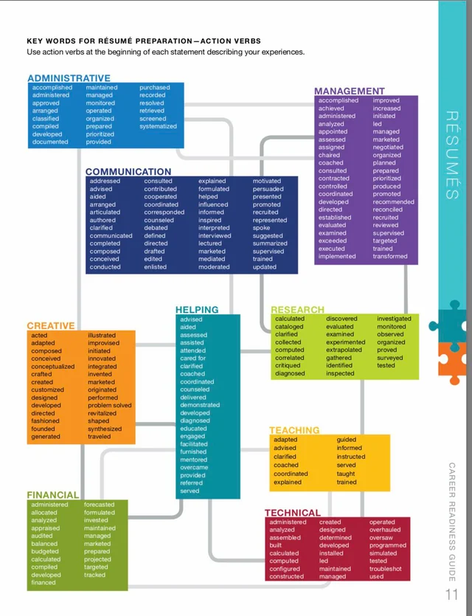
Content

Slide 14
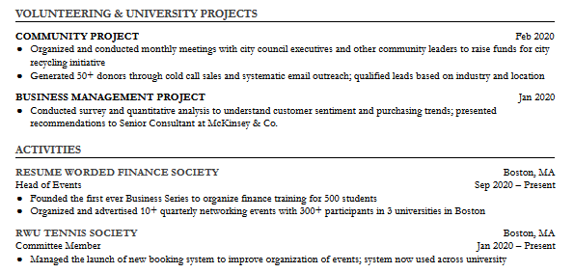
Content
Outcome:
Quantify!

Slide 15
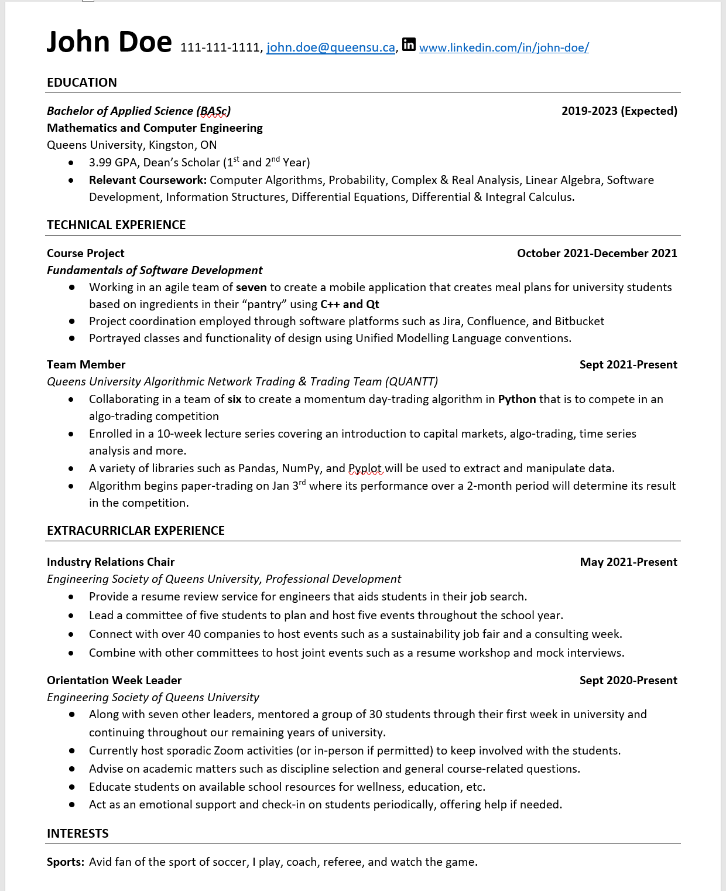
Format
1 PAGE
Margins/spacing
1-Liner bullet points
Relevant headings
Order of sections
Notes:
1 PAGE:
Always aim for 1 page
If 2 pages long, check to see if all information included is relevant
Margins
Do not sacrifice readability just so that resume is one page
Keep sufficient margins between lines so that resume is easy to navigate
1-liners
Enhances readability
Avoids clutter
Most bullet points can be described in one line anyways
Relevant Headings
Make sure the header of your section is specific to contents
Do not want vague headers
Order of Sections
Place in order of relevance
For the resume's format, you should aim to be as short and concise as possible, while still including all of the information you deem necessary. Shoot to have it fit to one page, but if that isn't possible 2 is usually ok. When using bullet points to describe experiences, try to describe each of your points in one line. Ensure that headings and subheadings are clearly visible and ordered in a way that puts the most relevant section closest to the beginning. (mention how top summarizes in one line). When you have completed your resume, it's always nice to have someone check it over to see if there are any instances where you could be more clear and concise.

Slide 16
Your Turn!

Slide 19
Additional Tips

Slide 20
Additional Tips
Save resume as FirstLastName-JobTitle.pdf

Slide 21
Additional Tips
MASTER RESUME

Slide 22
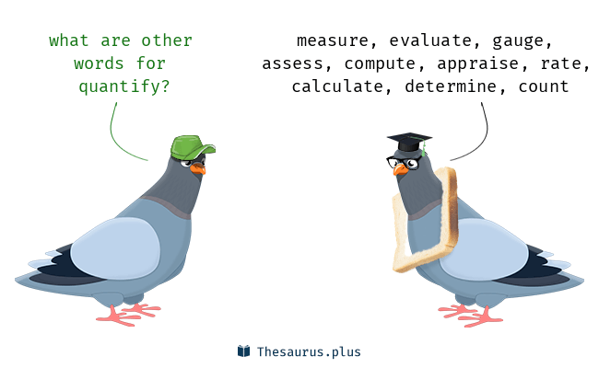
Additional Tips
Quantify, Quantify and…. Oh ya! QUANTIFY!

Slide 23
Additional Tips
Don’t include references

Slide 24
Additional Tips
Research your Position!

Slide 25
Additional Resources
Queen’s Resources
PD Resume Review
Queen’s Best Resumes
Tipsheets
MyCareer Resume Review
Not through Queen’s
Reddit @ r/resumes
Harvard resume guide: hes-resume-cover-letter-guide.pdf (harvard.edu)

Slide 26
Booking an Appointment
Career Services: Resume/Cover Letter Review
Notes:
An excellent resource for building a good resume is the one-on-one resume/cover letter review service put on by Queen's Career Services. This service can be accessed by appointment, where you will be put into a video call with a highly experienced Queen's student or employee who will help you with your resume or cover letter whether you are just beginning or have already finished. I will now take you through the steps of booking one of these appointments.

Slide 27
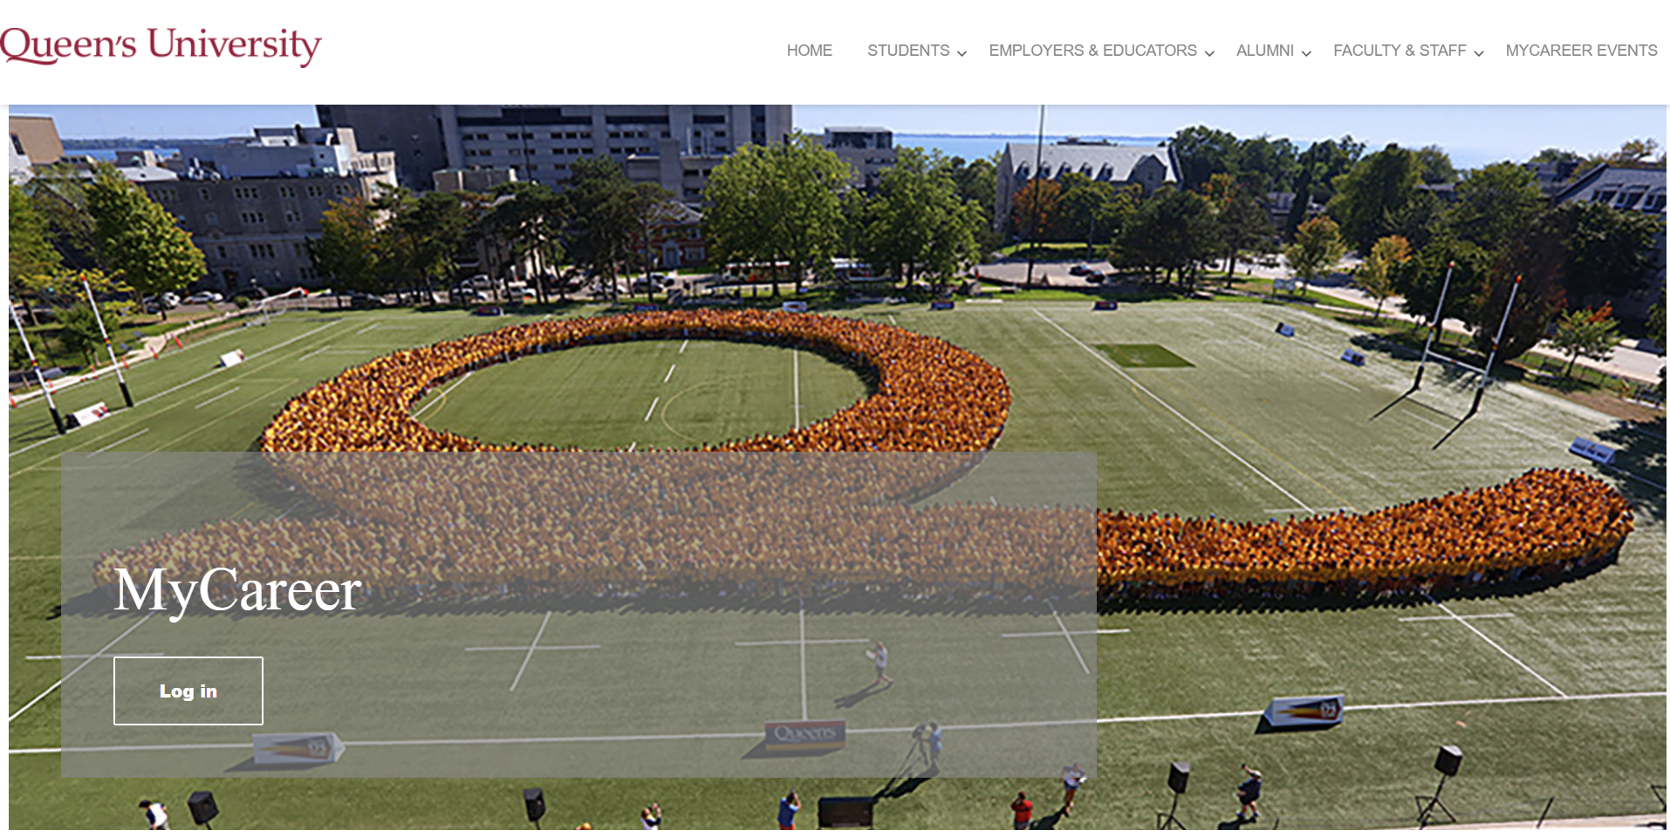
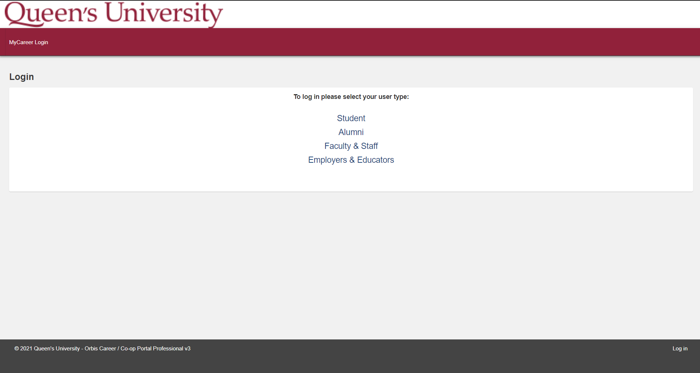
Step 1:
Google: "Queen's MyCareer or https://careers.sso.queensu.ca/home.htm

Slide 28
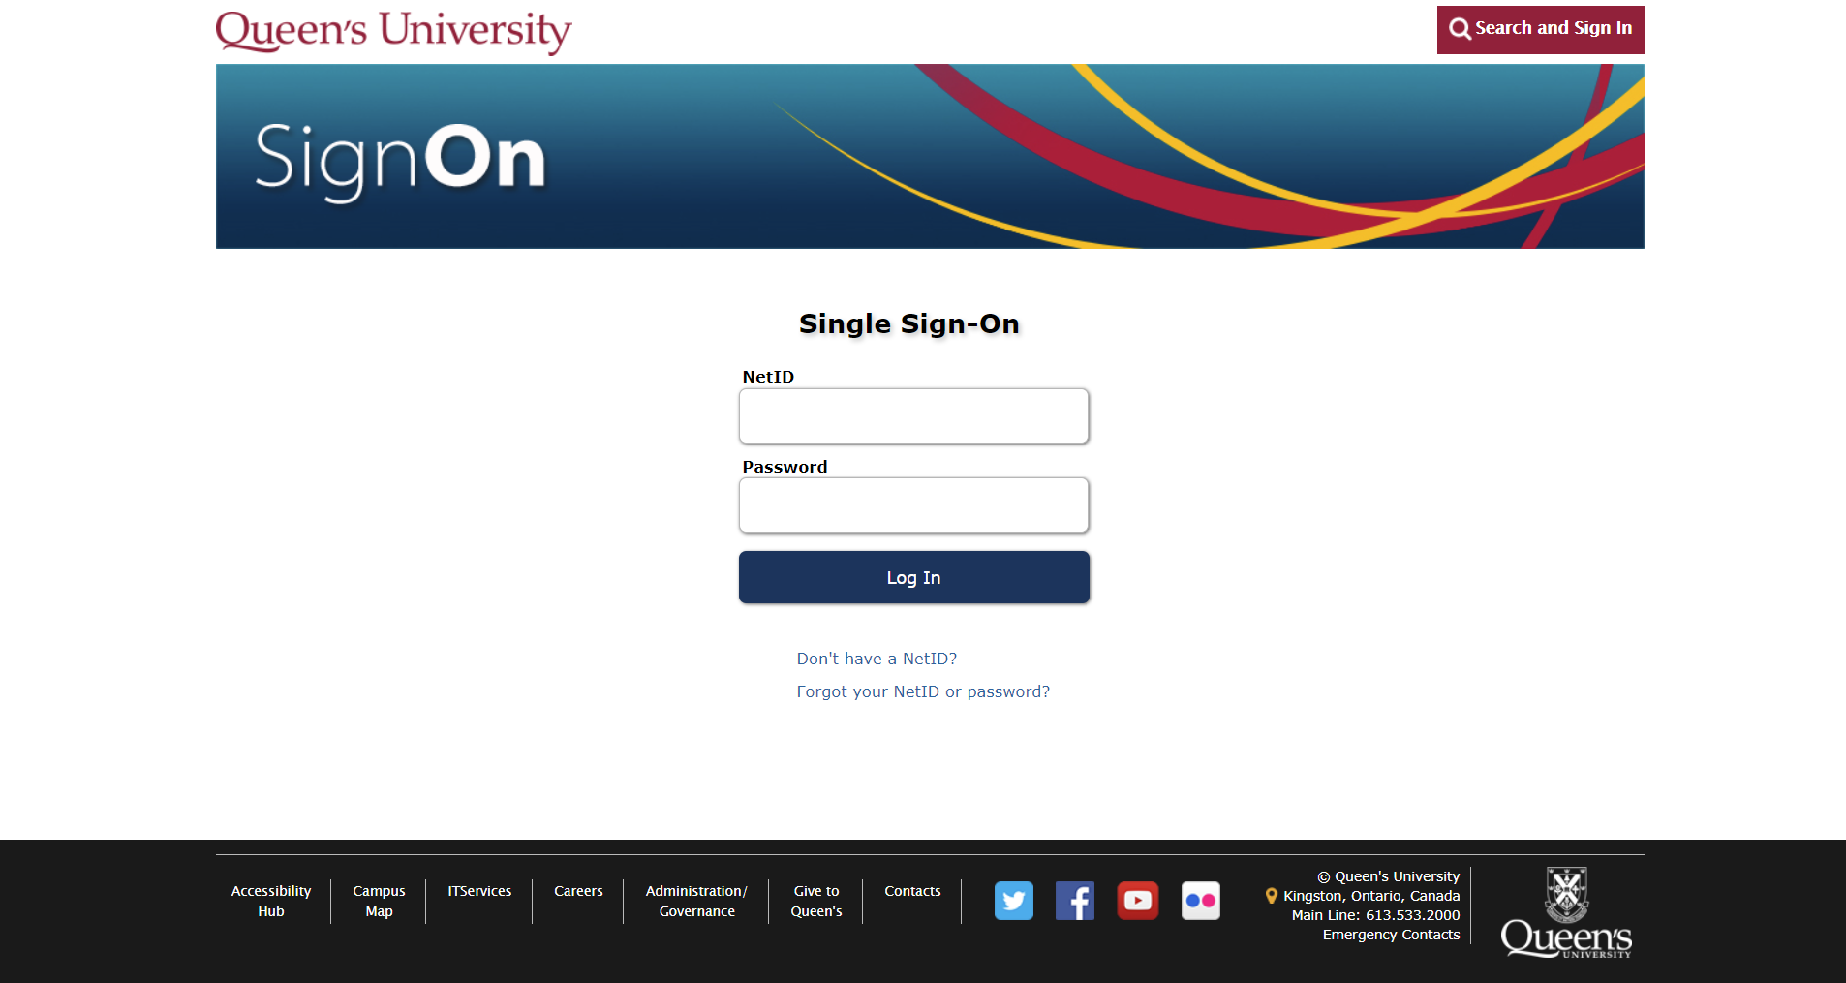
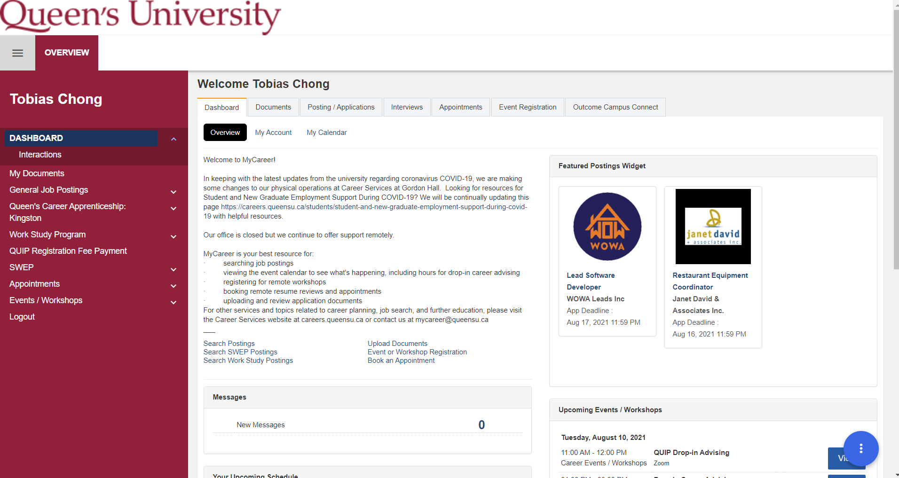
Step 2:

Slide 29
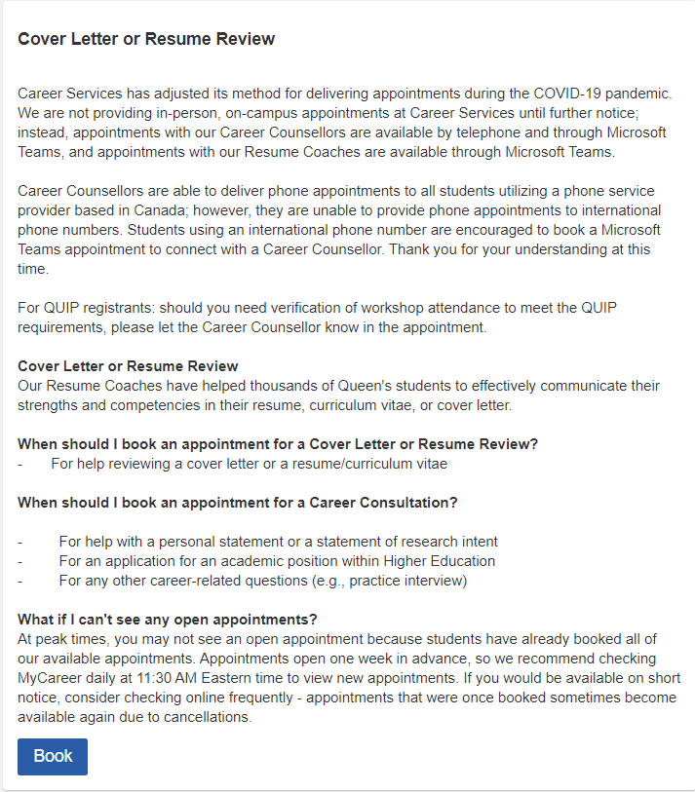
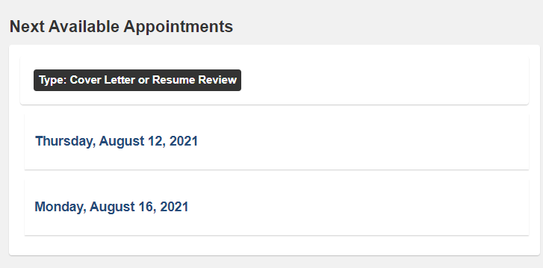
Step 3:

Slide 30
Thank you for Listening!
Any questions?
If you have any questions after you can reach me at:
industryrelations@engsoc.queensu.ca
Ilir Gusija | LinkedIn

